Slide 1
超越学科界限的认知基础 Transdisciplinary Cognitive Foundation Recursion, Continuation, and CICD/DevOps Week 07
Ben Koo
October 26, 2020

Slide 2
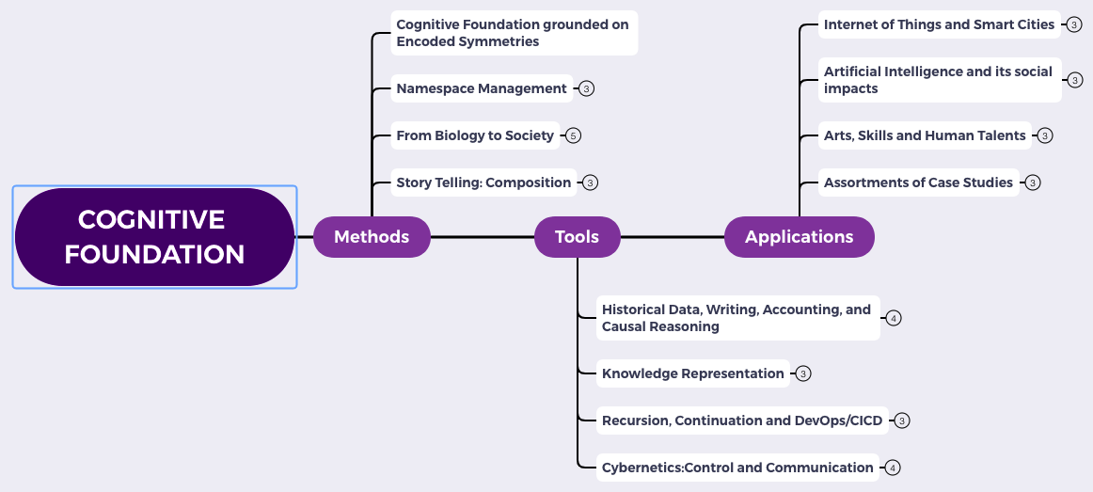
Content Themes for the semester
Overview
Namespace Management
Biology, Physics, Math, Code is Law, and Society
Story Telling, Functions/Metaphors/Analogies
Writing, Accounting, Historical Data and Temporal Reasoning
Knowledge Representation in Wiki and Files
Recursion and Continuation (DevOps/CICD)
Midterm Reports by Students
Cybernetics (Control and Communication)
Smart City and Internet of Things
Artificial Intelligence and its Social Impacts
Arts/Skills/Human Talents in the Digital Era
Student proposed Application Topics
Rehearsal
Final Reports and Celebration

Slide 3

Abstract Specification
Logic Model
Logic Model
Concrete Implementation
Context: Named Cognitive activities can be Computed at Scale
Goal: Show all computing process can be expressed in terms of Recursion
Criteria:
Consistent nomenclatures
Minimize cognitive complexity
Relate to societal practices
Output: An operational model for collective cognition
Process: Data Transformation activities
Input:
Theories on Recursive structures
Fundamental “bridging” analogies
Industrial practices at work
A well-defined set of Actions and iterative Branching Strategies
A Roadmap of composable activities
Sequencing and timing conditions
Explicitly state dependencies and resource requirements
Boundary Conditions: Farmilar with terminologies defined in previous lectures. i.e. Category Theory

Slide 4
Glossary
Ideas related to Knowledge Representation (week 6):
Partially Ordered Set (POS), Lattice, Initial and Terminal Objects, Limits, Co-limits.
Functors as Maps, Functors as Containers, Kan Extensions as Categories of Concepts
Static Analysis: Automatically discover properties for all possible paths of program execution
Terms to explain this week:
Recursive Functions: the source of complexity
Primitive Recursion: the ultimate standard for name management
Head and Tail Recursion: Trade offs between space and time

Slide 5
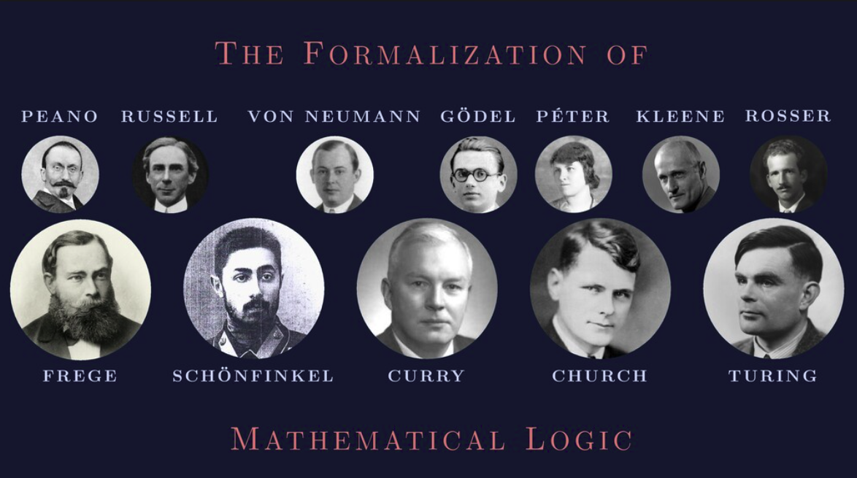
These Names are very useful to remember
Image Source: https://speakerdeck.com/glebec/lambda-calc-talk-frontside-version?slide=92

Slide 6
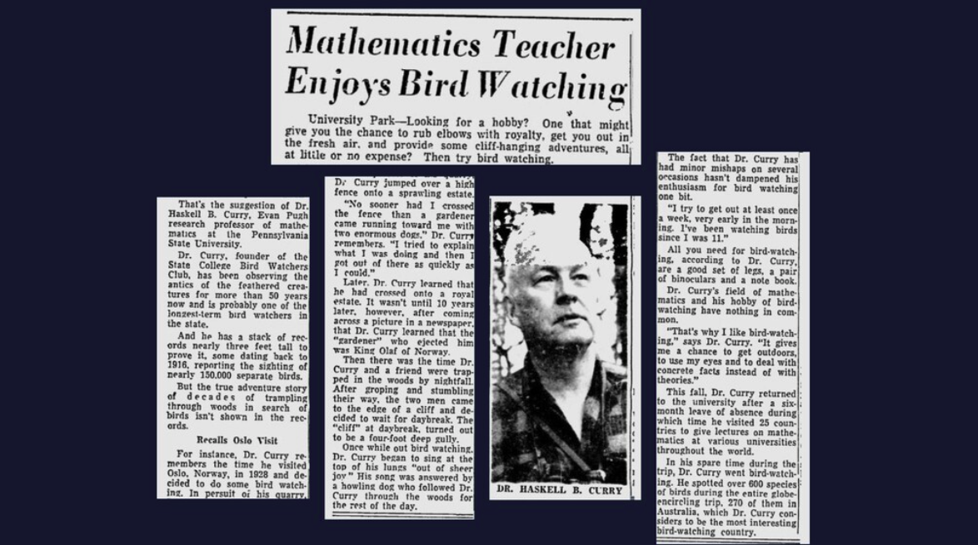
Name Management is a big deal
Image Source: https://speakerdeck.com/glebec/lambda-calc-talk-frontside-version?slide=90

Slide 7
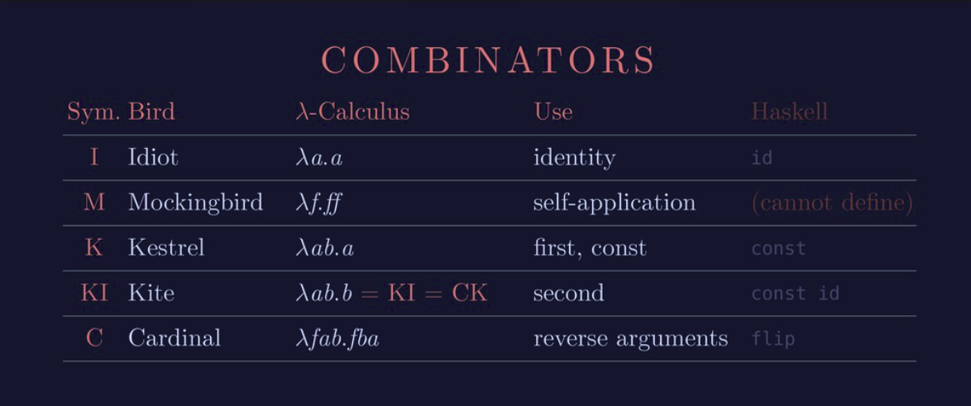
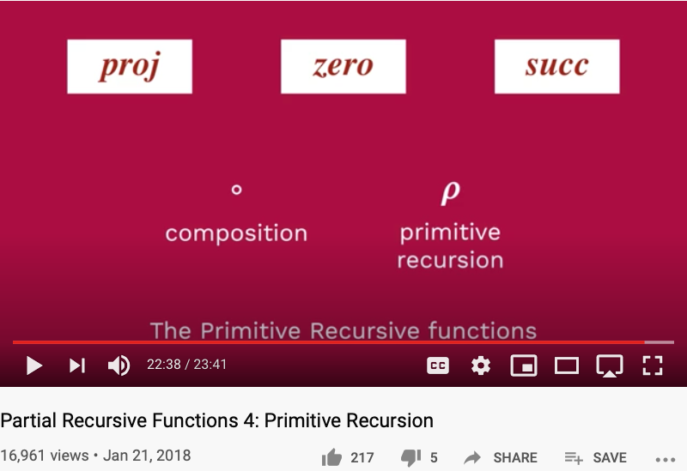
Five Critical Function Names
Idiot = identity = zero
Mockingbird = self-application = 𝜌
Kestrel = first, const = proj₁^{n}
Kite = second = proj₂^{n}
Cardinal = reverse arguments = a composition

Slide 8
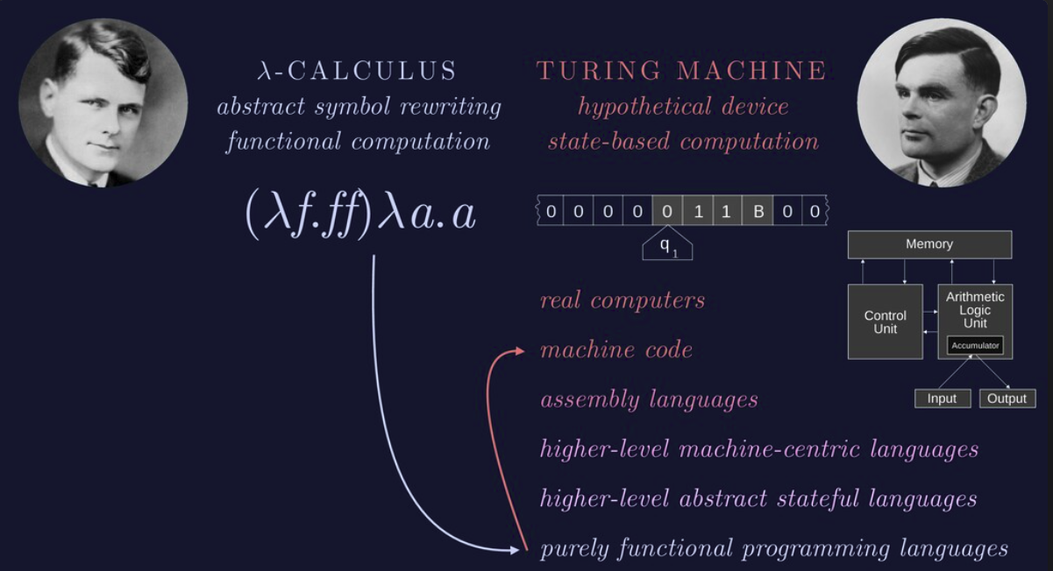
Lambda Calculus = Turing Machine

Slide 9
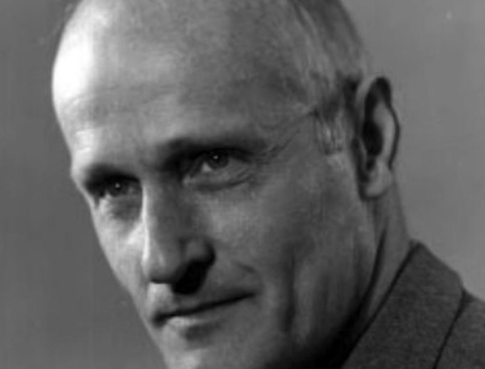
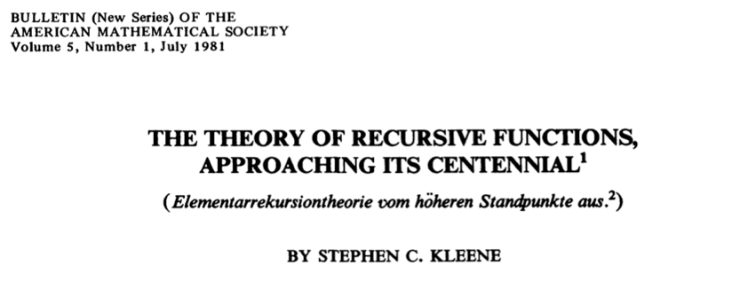
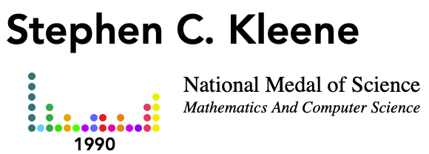
Stephen C. Kleene created Recursive Function Theory
An algorithm is a procedure, given by a finite set of instructions, to serve as follows in relation to a given infinite class of questions, (a) If we select any question from the class, the instructions will tell us how to perform a step, (b) After any step, if we do not receive the answer then, the instructions together with the existing situation will tell us what step to take next, (c) The instructions will enable us to recognize when a situation is reached in which the answer is before us, and to read it off then; and this will eventually happen if the question has an answer. …
For his leadership in the theory of recursion and effective computability and for developing it into a deep and broad field of mathematical research.

Slide 10
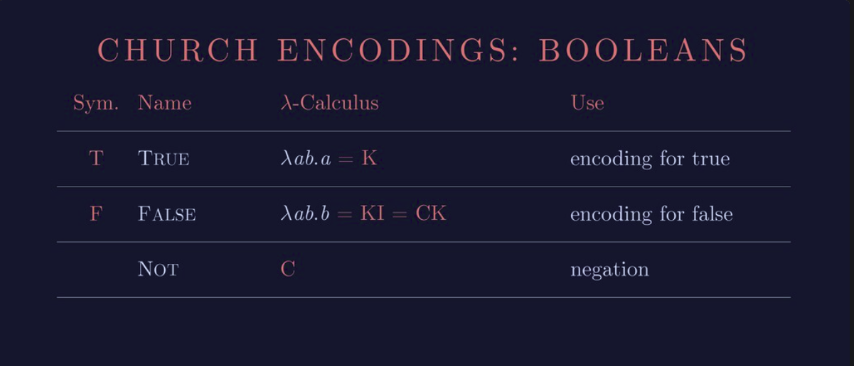
Lambda Calculus represents Boolean values
Huawei VP Mr. Yang Shaoqing
RICH 70 Tsinghua SEA Cloud Forum, Sep 14, 2020
H. E. Bambang Brodjonegoro,
Minister of Research & Technology, Indonesia

Slide 11

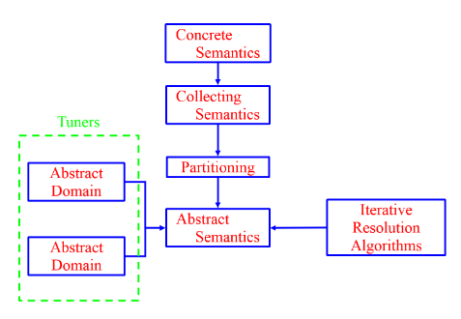
Recursion has Magic Powers
Multi-Level Recursion gives Practical Powers
Concrete Implementations can be realized using Galois Connections (a kind of recursion) introduced in Abstract Interpretation to automate verification and validatin activities.
Abstract Specification can be transformed into Primitive Recursive Functions based on Formal Methods and Model Checking Tools.
Image Source: Iowa State University: Wei Le

Slide 12
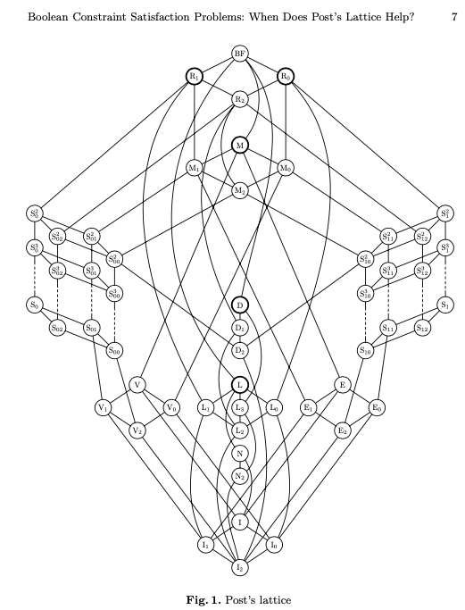
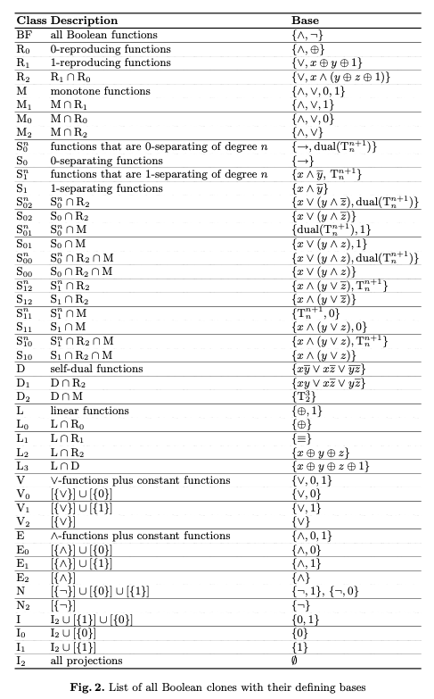
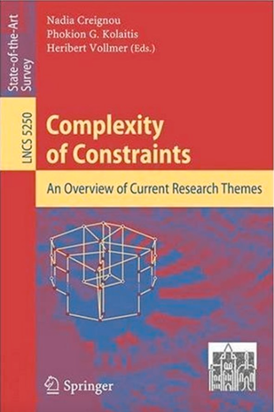
All Classes of Constraint Satisfaction Problems

Slide 13

The Master Algorithm that will rule the world?
Bill Gates recommended this book
in 2016 Code Conference
The thesis:
Processing data through a single universal learning algorithm— can get all the knowledge from the past, the present, and the future
Pedro Domingos, TMA, P. 25
Chinese Translation
13

Slide 14

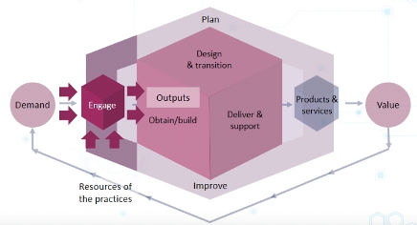
Abstract Specification
Concrete Implementation
A well-defined set of Actions and iterative Branching Strategies
A Roadmap of composable activities
Sequencing and timing conditions
Explicitly state dependencies and resource requirements
Namespace Management

Slide 15
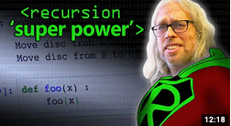
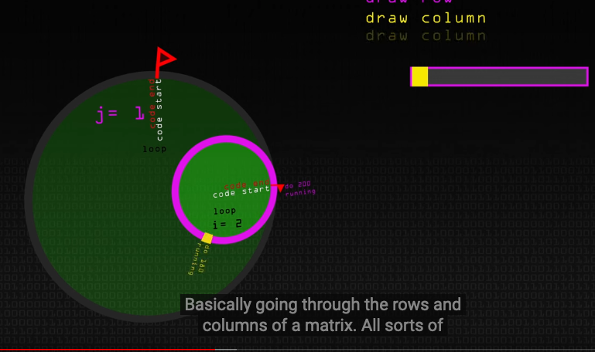
The Magical Power of Recursion
Huawei VP Mr. Yang Shaoqing
Video last viewed: October 26, 2020.
Video last viewed: October 26, 2020.

Slide 16
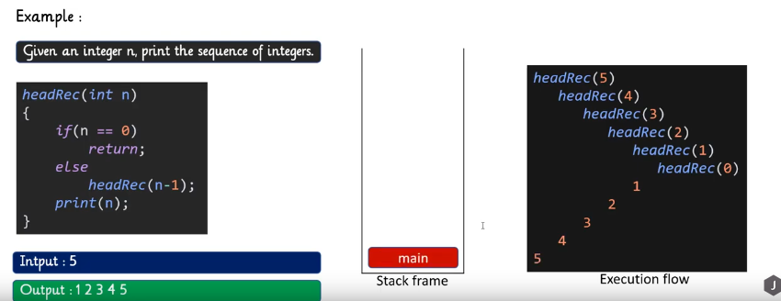
Head Recursion
Huawei VP Mr. Yang Shaoqing
Video last viewed: October 26, 2020.

Slide 17
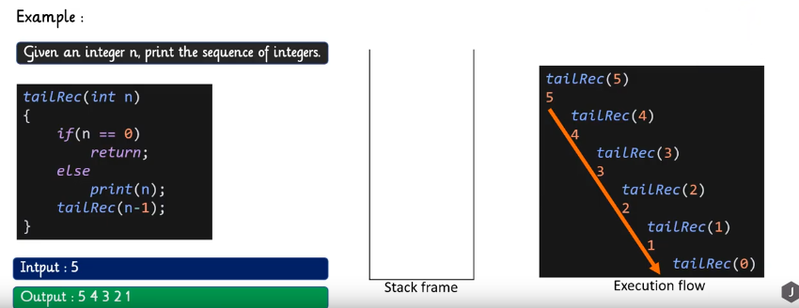
Tail Recursion
Huawei VP Mr. Yang Shaoqing
Video last viewed: October 26, 2020.

Slide 18
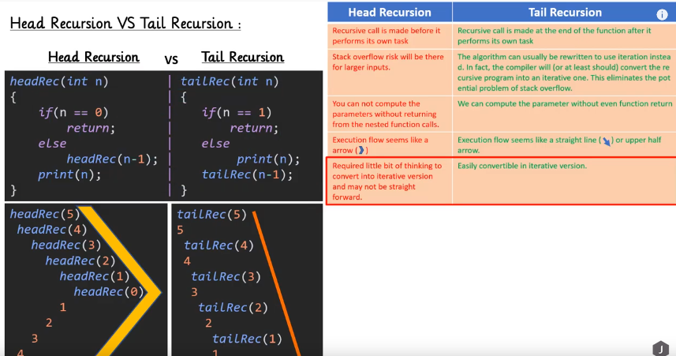
Comparing Head and Tail Recursion
Huawei VP Mr. Yang Shaoqing
Video last viewed: October 26, 2020.

Slide 19
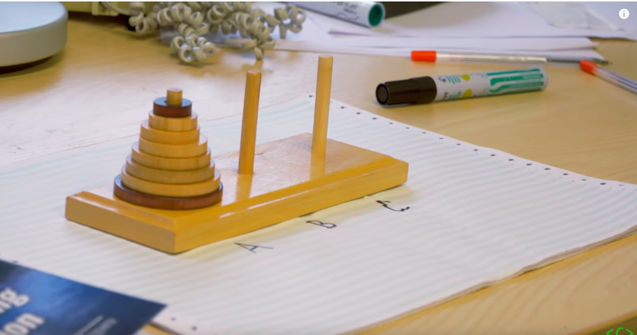
A Typical Example of Recursion
Huawei VP Mr. Yang Shaoqing
Video last viewed: October 26, 2020.

Slide 20
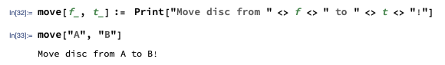
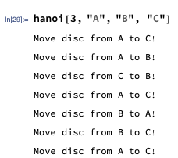
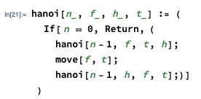
A Sequence of Actions as a Path
Huawei VP Mr. Yang Shaoqing

Slide 21
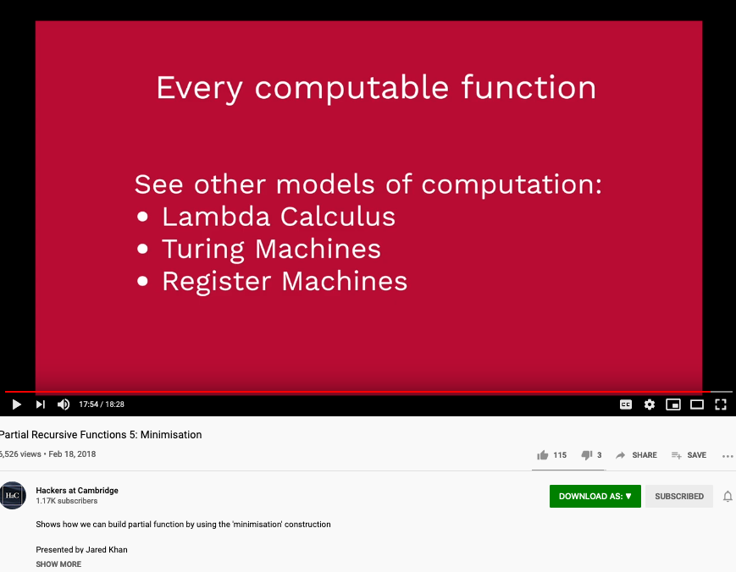
Primitive Recursion’s Universal Power
Huawei VP Mr. Yang Shaoqing
Video last viewed: October 26, 2020.

Slide 22
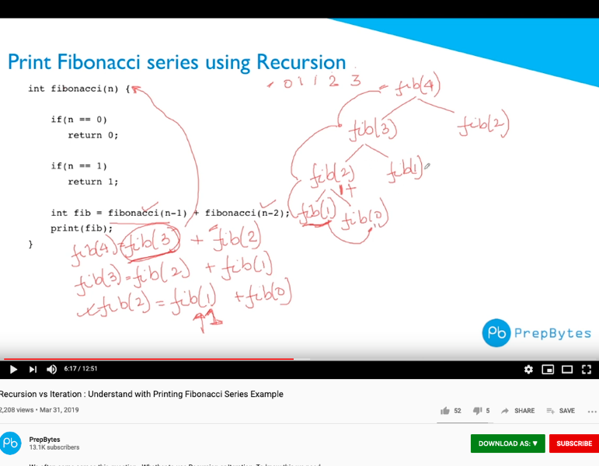
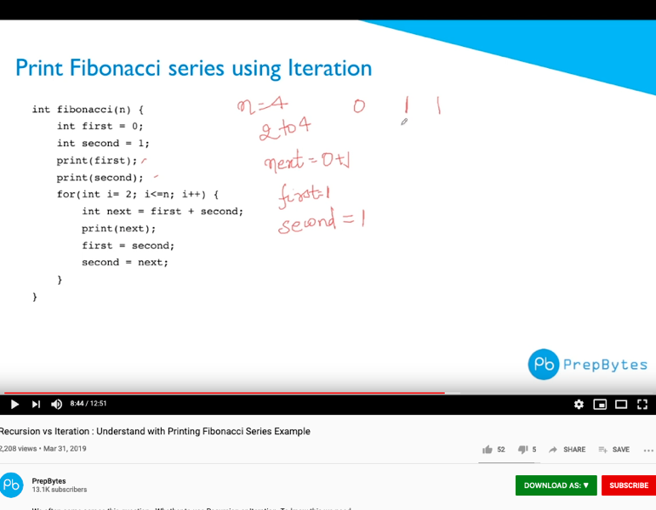
The Choices between Recursion or Iteration?
Huawei VP Mr. Yang Shaoqing
Video last viewed: October 26, 2020.
Video last viewed: October 26, 2020.

Slide 23
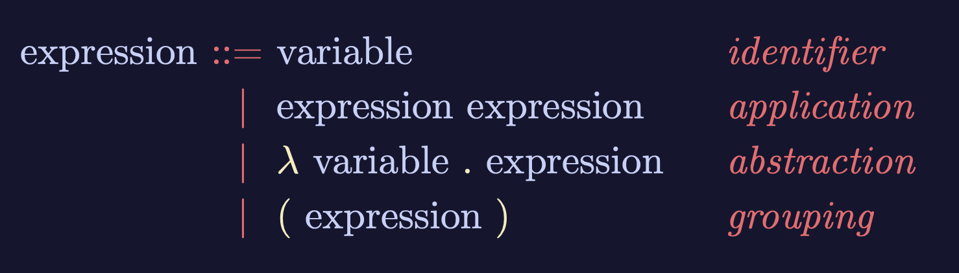
A Generalized Recursive Function
Image Source: https://speakerdeck.com/glebec/lambda-calc-talk-frontside-version?slide=66

Slide 24
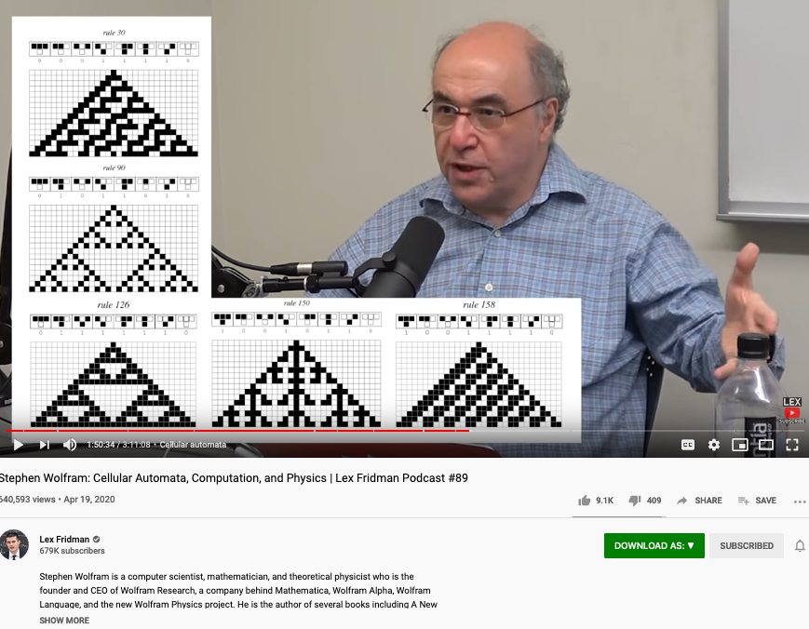
Discovering functions through enumerated function space
Huawei VP Mr. Yang Shaoqing
Video last tested: October 24, 2020.

Slide 25
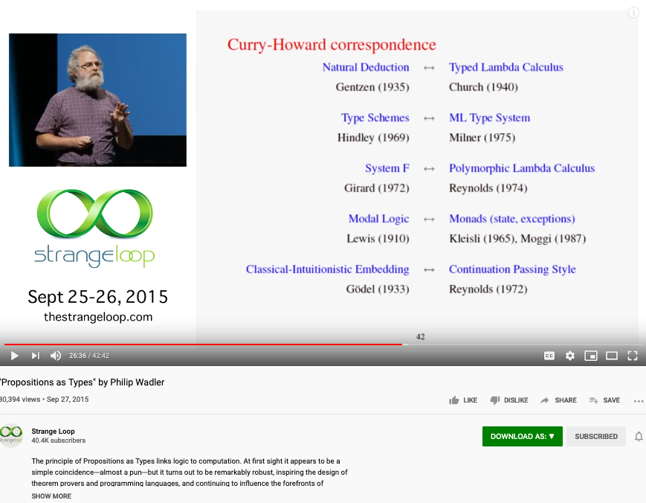
Is Math Proofs Invented or Discovered?
Huawei VP Mr. Yang Shaoqing
Video last tested: October 24, 2020.

Slide 26
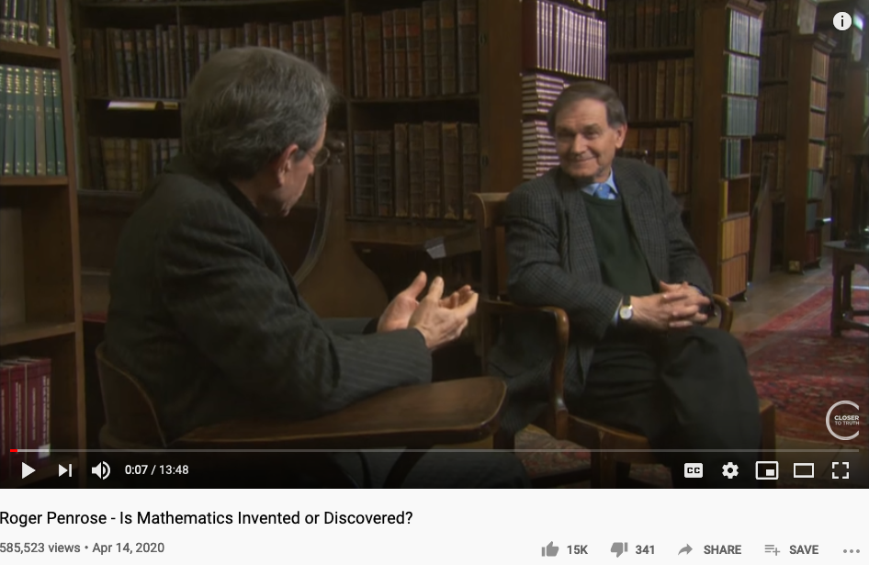
Is Math Invented or Discovered?
Huawei VP Mr. Yang Shaoqing
Video last tested: October 24, 2020.

Slide 27
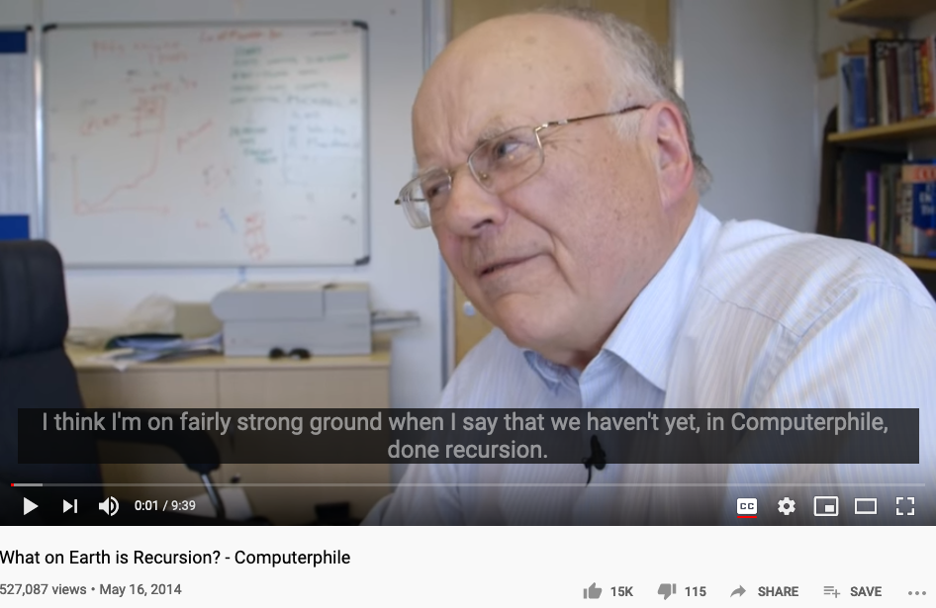
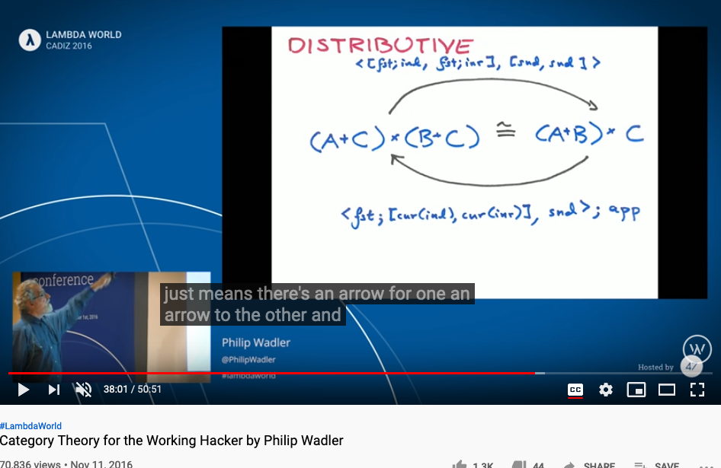
Is Recursion Invented or Discovered?
Huawei VP Mr. Yang Shaoqing
Video last tested: October 24, 2020.
Video last tested: October 24, 2020.

Slide 28
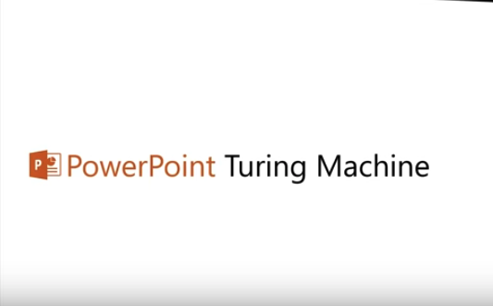
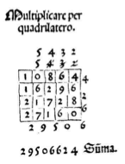
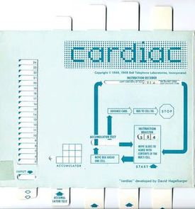
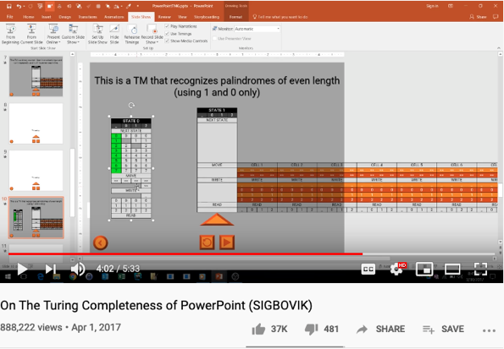
Computational Operations on Paper
https://youtu.be/uNjxe8ShM-8
A way to perform multiplication using matrix layout in Pacioli’s book.

Slide 29



Metaphors and Story Telling

Slide 30
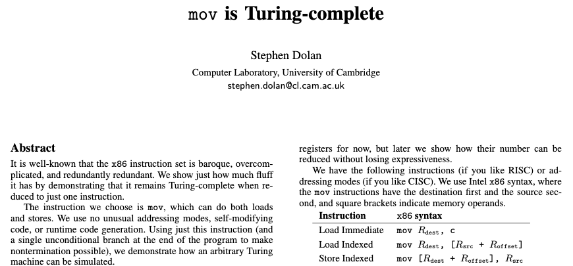
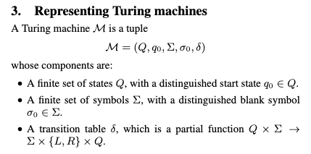
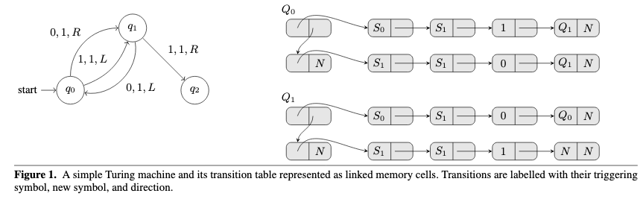
Turing Complete Instruction Set
Paper Download Link: https://drwho.virtadpt.net/files/mov.pdf

Slide 31
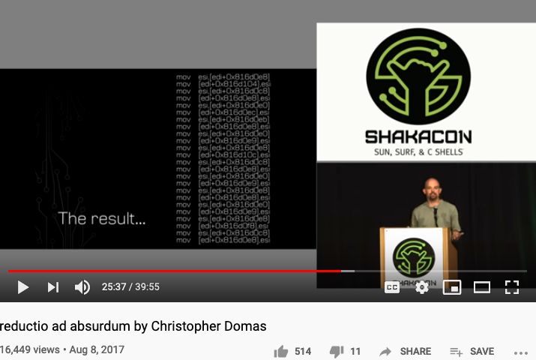
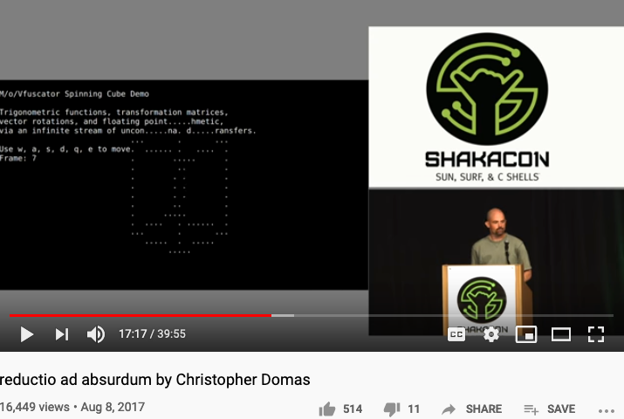
One instruction for All Computation
https://youtu.be/NmWwRmvjAE8?t=1037
Representing all computational actions with just one instruction, MOV

Slide 32
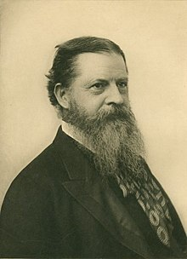
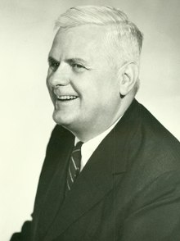
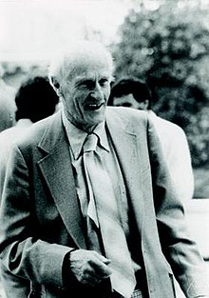
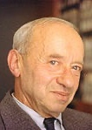

The Sources of these Ideas
Charles Sanders Pierce
Alonzo Church
Stephen Cole Kleene
Alfred Tarski
Dana Scott

Slide 33


Charles Sanders Pierce and Arrows
The NOR operator is also known as Peirce's arrow—Charles Sanders Peirce introduced the symbol ↓ for it,^{[1]}
Charles Sanders Pierce

Slide 34
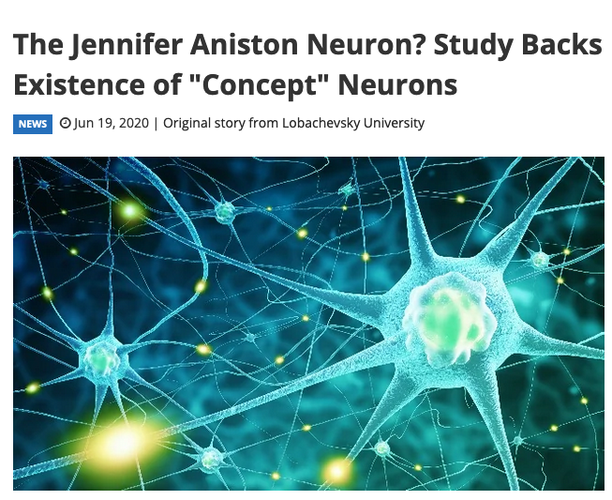
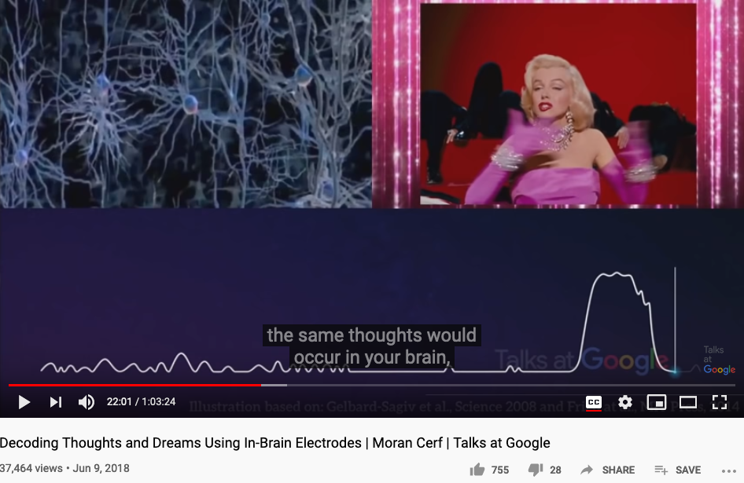
Charles Sanders Pierce and Arrows
The web report
Google Talk 2018 by Moran Cerf

Slide 35
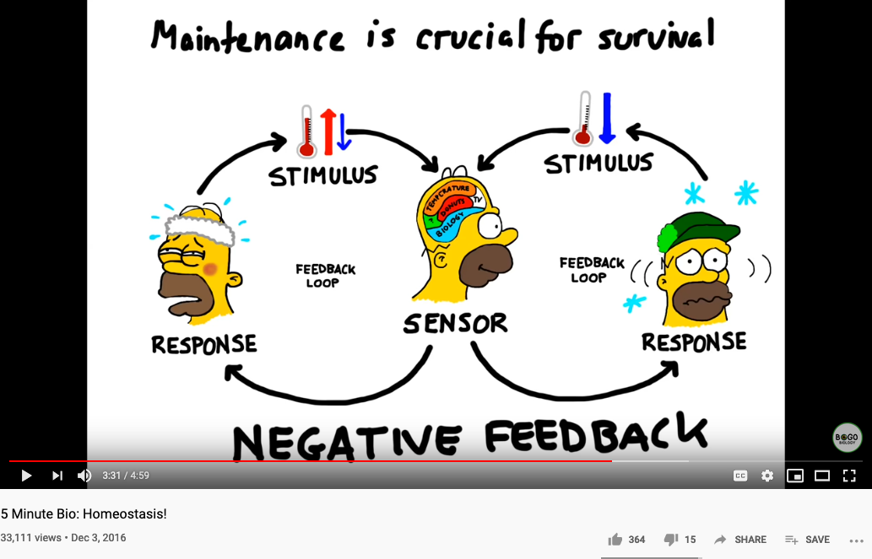
Biology and Physiology

Slide 36
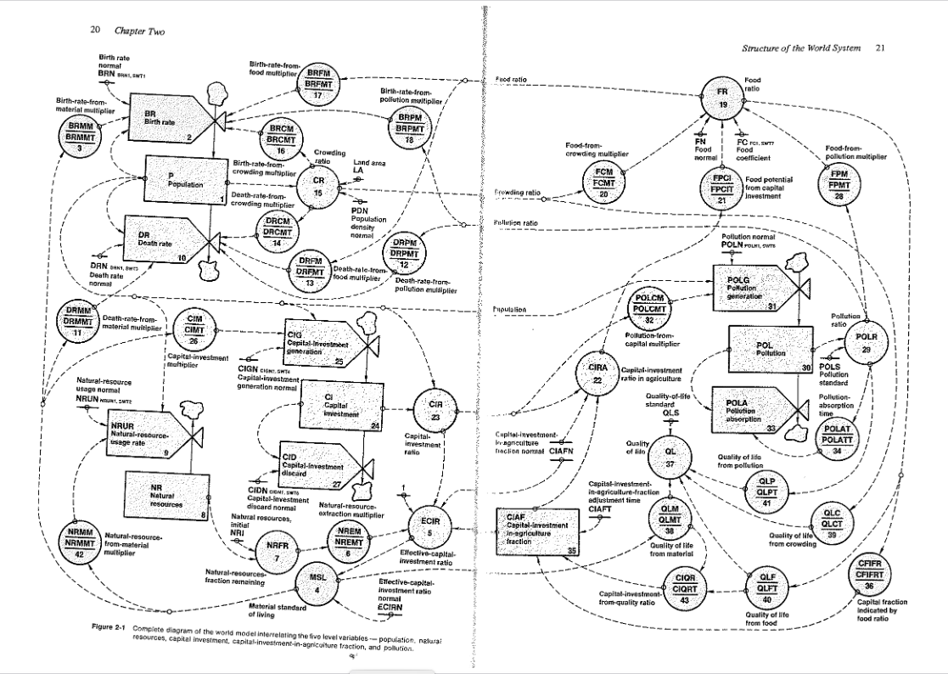

Industrial and World Dynamics
The World is made of three kinds of things:
Stock, Flow, and State variables parameterized in time

Slide 37


NsM under a Biological/Economic Control System
Image Source: From autopoiesis to neurophenomenology: Francisco Varela's exploration of the biophysics of being,
DAVID RUDRAUF, ANTOINE LUTZ, DIEGO COSMELLI, JEAN-PHILIPPE LACHAUX, and MICHEL LE VAN QUYEN

Slide 38







All System can be approximated as Partially Ordered Set
Numbers are naturally related to Music:

Slide 39

A Categorical Manifesto
Welcome to the web site of the KMR group! We are based at the School of Electrical Engineering and Computer Science EECS [formerly (= pre 2018) the School of Computer Science and Communication] (CSC) at the KTH Royal Institute of Technology in Stockholm, Sweden.
… the Fifth Dogma:
Given a category of widgets, the operation of putting a system of widgets together to form some super-widget corresponds to taking the colimit of the diagram of widgets that shows how to interconnect them.
At least for me, this dogma first appeared in the context of General Systems Theory.
////// End of quote from Joseph Goguen’s Categorical Manifesto

Slide 40

The ”POS” of knowledge representation by KMR
Image Source: KMR group of KTH Royal Institute of Technology in Stockholm, Sweden.

Slide 41

A Must Watch Video on Monad
https://youtu.be/OSuu8zBBNAA?t=857

Slide 42

Abstraction
Concretization
Serve as the Control Plane
Define Policies according to high level objectives
Security roles protected by tech not by political influence only
Law enforcement by controlling targeted resources in the Data Plane
Serve as the Data Plane
Resources governed by Configurable Policies
Security-sensitive infrastructure that assigns traceable responsibilities to persons
Provide feedback from real worlds to reflect on the efficacies of laws
A well-defined set of Actions and iterative Branching Strategies
A Roadmap of composable activities
Sequencing and timing conditions
Explicitly state dependencies and resource requirements
Namespace (Data Asset) Management

Slide 43


Reserved Names and Constants in Sciences
Unzicker’s Observations:
Revolutions in physics have always eliminated arbitrary numbers
A complete theory of reality must do without any constants of nature
https://youtu.be/zxAV_Re4OWA?t=239
https://youtu.be/zxAV_Re4OWA?t=323
On the origin of constants C and h, by Alexander Unzicker, last accessed Oct 20, 2020

Slide 44
Concrete Activities in Daily Workflow
What is DevSecOps?
Image courtesy: Paladion Corporation Website Image source: https://www.paladion.net

Slide 45


Names gave birth to Cognitive Abilities - Laozi
Huawei VP Mr. Yang Shaoqing
RICH 70 Tsinghua SEA Cloud Forum, Sep 14, 2020
H. E. Bambang Brodjonegoro,
Minister of Research & Technology, Indonesia

Slide 46



The History of True Names
Huawei VP Mr. Yang Shaoqing
RICH 70 Tsinghua SEA Cloud Forum, Sep 14, 2020
H. E. Bambang Brodjonegoro,
Minister of Research & Technology, Indonesia
How Gods are forgotten:
https://youtu.be/xgyMY9w7-ew?t=278

Slide 47


The Meaning of being True
Huawei VP Mr. Yang Shaoqing
RICH 70 Tsinghua SEA Cloud Forum, Sep 14, 2020
H. E. Bambang Brodjonegoro,
Minister of Research & Technology, Indonesia
Russel once said: “Mathematicians’ job is about classifiying.”
Mathematics is the art of giving the same name to different things.^{[10]} Henri Poincaré

Slide 48



“Mathematics is the art of giving the same name to different things!” - Henry Poincare

Slide 49


The monad, about which we shall speak here, is nothing other than a simple substance which enters into compounds, ‘simple’ meaning ‘without parts’. - Leibniz
Monad: Leibniz’s Universal Abstraction Unit

Slide 50
Your action on Recursion before November 2, 2020
Think about where your project would use Recursion or Iteration
Explicitly point out the aspect of your project, where recursion/iterations are used
How’s recursion or iteration is formulated in your project
What is the space-time budget for your strategy of Recursion/Iteration
Prepare a complete outline of your learning report.
Show a complete Logic Model on November 2nd ,2020
A complete Table of Content for the Report

